Slide 1


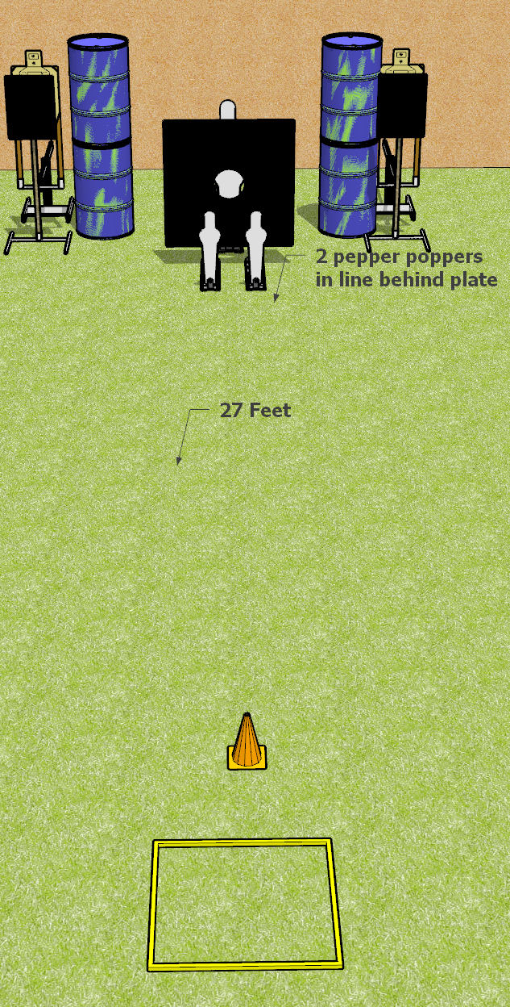
 | Dothan Gun Club – USPSA Match Be Quick Course Designer : Drew Coleman
START POSITION : Standing inside shooting box, hands relaxed at sides
GUN READY CONDITION : Pistol loaded and holstered. PCC loaded, shouldered, safety on, pointed at orange cone. |  | SCORING: Comstock, 8 rounds TARGETS: 2 paper, 4Steel SCORED HITS: Best 2 on paper, steel until down START-STOP: Audible, last shot RULES:
STAGE PROCEDURE: Engage targets as they become available from within the fault lines.

Slide 2
Be Quick
Written Stage Briefing
Be Quick is an 8 round, 40 point, Comstock Speed Shoot. There are two USPSA paper targets, 2 pepper poppers, and 2 mini poppers. The best two hits per target will score. Steel must fall to score. The start signal is audible.
The start position is standing in shooting box with hands relaxed at sides. Handgun is loaded and holstered.
The PCC start position is standing in shooting box with loaded carbine held in both hands, safety on, shouldered, muzzle pointed at orange cone.
Upon start signal, engage targets as they become available from within the shooting area.

Slide 3
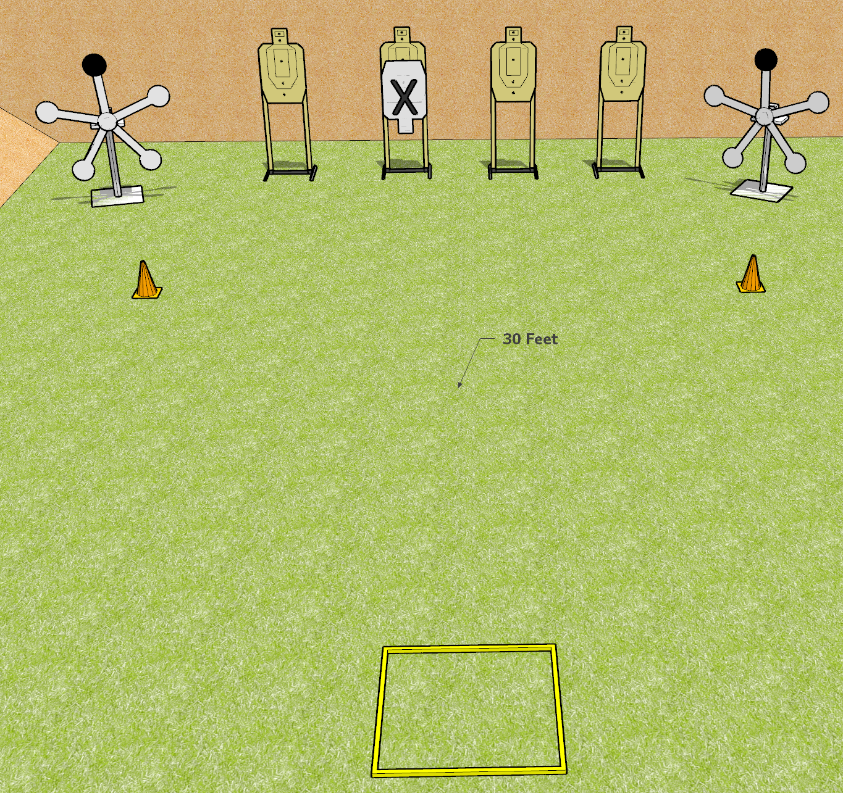
 | Dothan Gun Club – USPSA Match Seeing Stars Course Designer : Drew Coleman
START POSITION : Standing in shooting box, wrists above shoulders
GUN READY CONDITION : Pistol loaded and holstered. PCC loaded, shouldered, safety on, pointed at either orange cone. |  | SCORING: Comstock, 16 rounds TARGETS: 4 paper, 8 Steel SCORED HITS: Best 2 on paper, steel until down START-STOP: Audible, last shot RULES: failure to make a mandatory reload before changing arrays will be a procedural per shot fired. Be sure that the black painted plate is on top for each competitor
STAGE PROCEDURE: Engage either the paper or the steel, then perform a mandatory reload and engage the remaining array.

Slide 4
Seeing Stars
Written Stage Briefing
Be Quick is a 16 round, 80 point, Comstock speed shoot. There are four paper USPSA targets, and eight falling plates. The best two hits per target will score. Steel must fall to score. The start signal is audible.
The black plates on the Texas Star are hard cover and do not count for score or penalty.
The start position is standing in shooting box with wrists above respective shoulders. Handgun is loaded and holstered.
PCC start position is standing in shooting box with loaded carbine held in both hands, safety on, shouldered, muzzle pointed at either orange cone.
Upon start signal, engage the paper targets OR the steel, perform a mandatory reload, and engage the remaining array

Slide 5
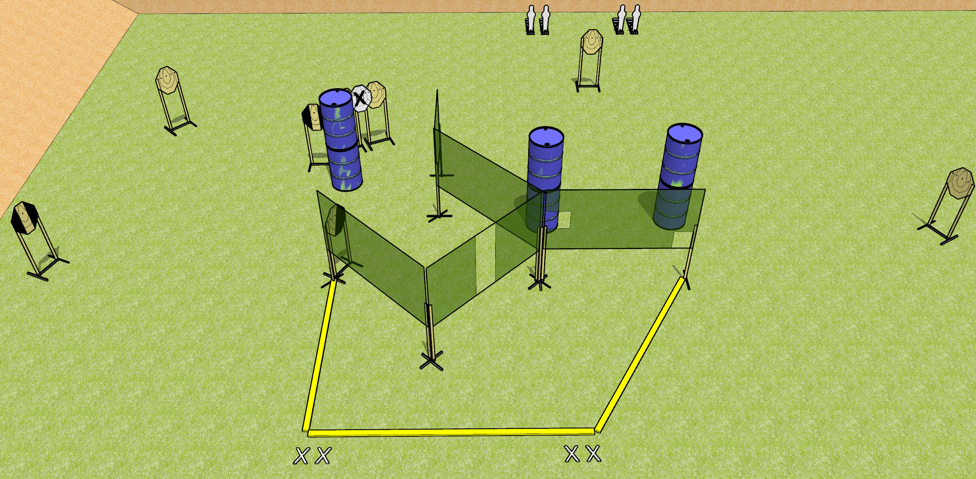
 | Dothan Gun Club – USPSA Match Punch Buggy Redux Course Designer : Drew Coleman
START POSITION : Standing with both feet on X’s, wrists above shoulders
GUN READY CONDITION : Pistol loaded and holstered. PCC loaded, buttstock on belt, safety on, pointed in a safe direction |  | SCORING: Comstock, 20 rounds TARGETS: 8 paper, 4 Steel SCORED HITS: Best 2 on paper, steel until down START-STOP: Audible, last shot RULES:
STAGE PROCEDURE: Engage targets as they become available from within the fault lines.

Slide 6
Punch Buggy Redux
Written Stage Briefing
Punch Buggy Redux is a 20 round, 100 point, Comstock Medium Course. There are eight IPSC paper targets, and four mini poppers. The best two hits per target will score. Steel must fall to score. The start signal is audible.
The handgun start position is standing outside shooting area with both feet on X’s with wrists above respective shoulders. Handgun is loaded and holstered.
The PCC start position is standing outside the shooting area with both feet on X’s. Loaded carbine held in both hands, safety on, buttstock touching belt, muzzle pointed in a safe direction.
Upon start signal, engage targets as they become available from within the shooting area.

Slide 7
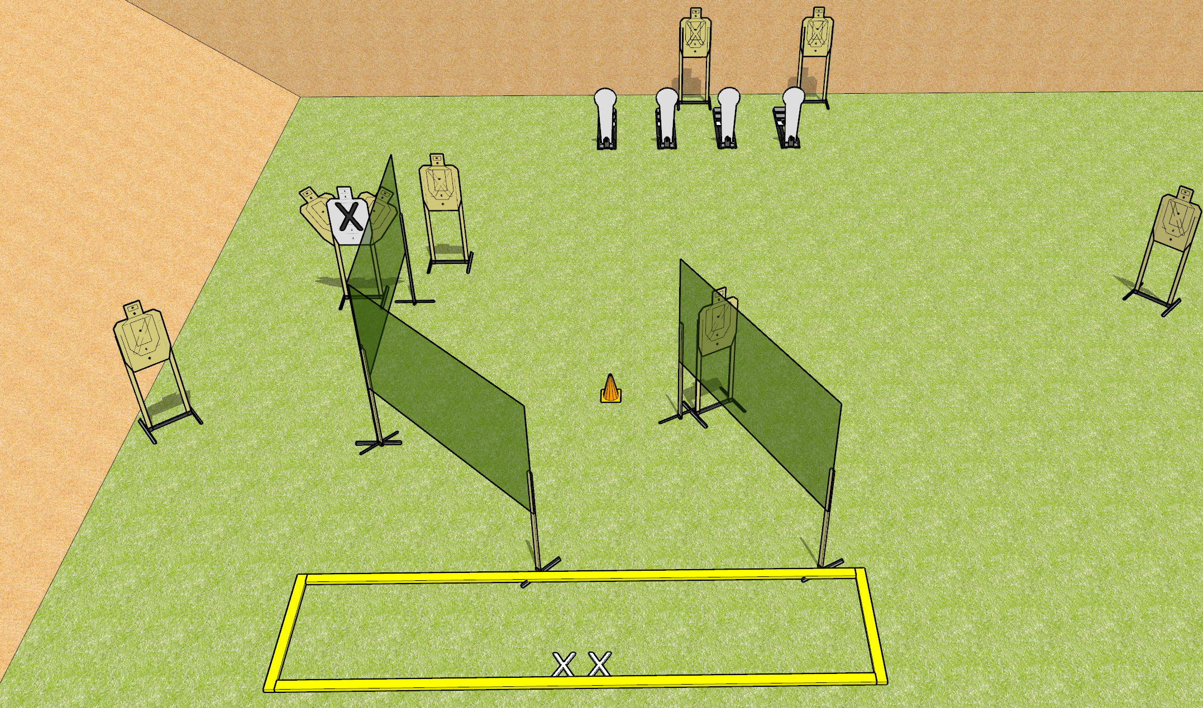
 | Dothan Gun Club – USPSA Match What Was I Thinking? Course Designer : Drew Coleman
START POSITION : Standing with both feet on X’s, hands relaxed at sides
GUN READY CONDITION : Pistol loaded and holstered. PCC loaded, shouldered, safety on, pointed at orange cone. |  | SCORING: Comstock, 20 rounds TARGETS: 8 paper, 4 Steel SCORED HITS: Best 2 on paper, steel until down START-STOP: Audible, last shot RULES:
STAGE PROCEDURE: Engage targets as they become available from within the fault lines.

Slide 8
What Was I Thinking?
Written Stage Briefing
What Was I Thinking? is a 20 round, 100 point, Comstock Medium Course. There are eight IPSC paper targets, and four Colt Speed Steel targets. The best two hits per target will score. Steel must fall to score. The start signal is audible.
The handgun start position is standing inside the shooting area with both feet on X’s with hands relaxed at sides. Handgun is loaded and holstered.
The PCC start position is standing inside the shooting area with both feet on X’s. Loaded carbine held in both hands, safety on, shouldered, with muzzle pointed at orange cone.
Upon start signal, engage targets as they become available from within the shooting area.

Slide 9
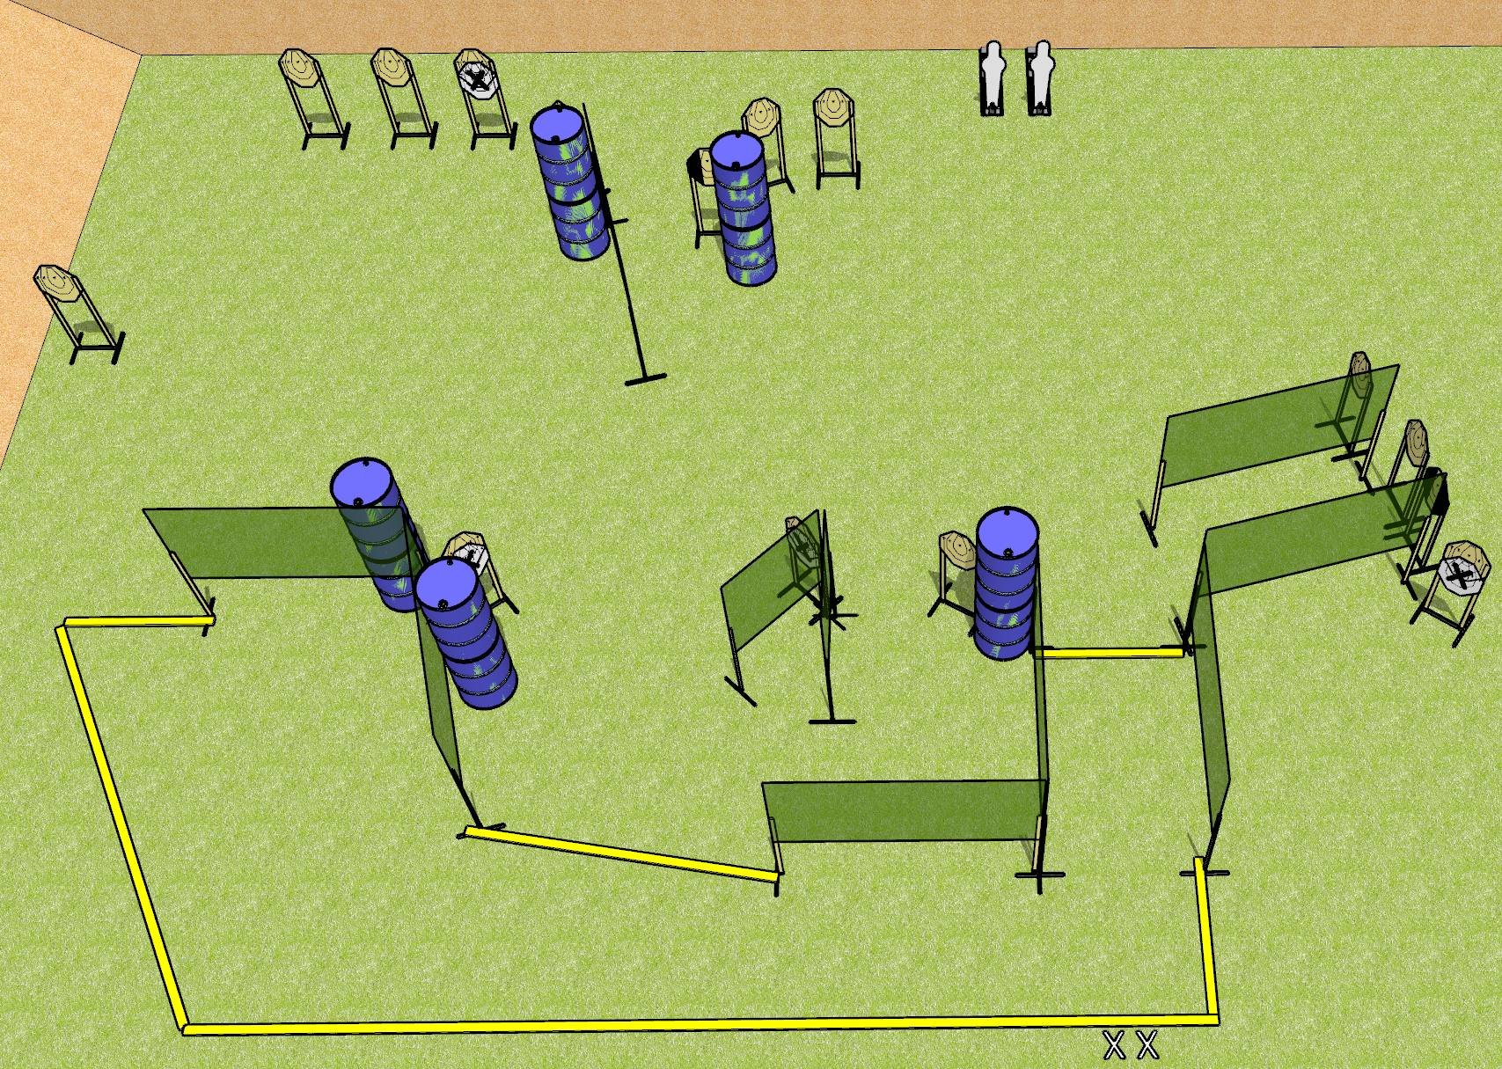
 | Dothan Gun Club – USPSA Match Gotta Move Course Designer : Drew Coleman
START POSITION : Standing with both feet on X’s, hands relaxed at sides
GUN READY CONDITION : Pistol unloaded and holstered. PCC unloaded, buttstock on belt, pointed downrange. |  | SCORING: Comstock, 32 rounds TARGETS: 15 paper, 2 Steel SCORED HITS: Best 2 on paper, steel until down START-STOP: Audible, last shot RULES:
STAGE PROCEDURE: Engage targets as they become available from within the fault lines.
Vampire Target

Slide 10
Gotta Move
Written Stage Briefing
Gotta Move is a 32 round, 160 point, Comstock Field Course. There are fifteen IPSC paper targets, and two pepper poppers. The best two hits per target will score. Steel must fall to score. The start signal is audible.
The handgun start position is standing outside the shooting area with both feet on X’s with hands relaxed at sides. Handgun is unloaded and holstered.
The PCC start position is standing outside the shooting area with both feet on X’s. Unloaded carbine held in both hands, safety on, buttstock on belt, muzzle pointed downrange.
Upon start signal, engage targets as they become available from within the shooting area.

Slide 11
Vampire Target

Slide 12
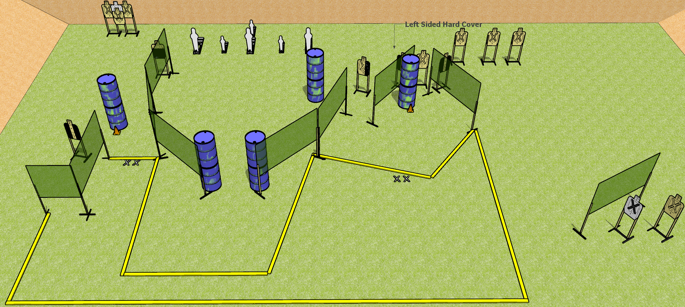
 | Dothan Gun Club – USPSA Match But Where? Course Designer : Drew Coleman
START POSITION : Standing with both feet on either set of X’s, hands relaxed at sides
GUN READY CONDITION : Pistol loaded and holstered. PCC loaded, shouldered, safety on, pointed at either orange cone. |  | SCORING: Comstock, 32 rounds TARGETS: 13 paper, 6 Steel SCORED HITS: Best 2 on paper, steel until down START-STOP: Audible, last shot RULES:
STAGE PROCEDURE: Engage targets as they become available from within the fault lines.

Slide 13
But Where?
Written Stage Briefing
But Where? is a 32 round, 160 point, Comstock Field Course. There are thirteen USPSA paper targets, three pepper poppers, and three mini poppers. The best two hits per target will score. Steel must fall to score. The start signal is audible.
The handgun start position is standing inside the shooting area with both feet on either set of X’s with hands relaxed at sides. Handgun is loaded and holstered.
The PCC start position is standing inside the shooting area with both feet on either set of X’s. Loaded carbine held in both hands, safety on, shouldered, muzzle pointed at either orange cone.
Upon start signal, engage targets as they become available from within the shooting area.

Slide 14
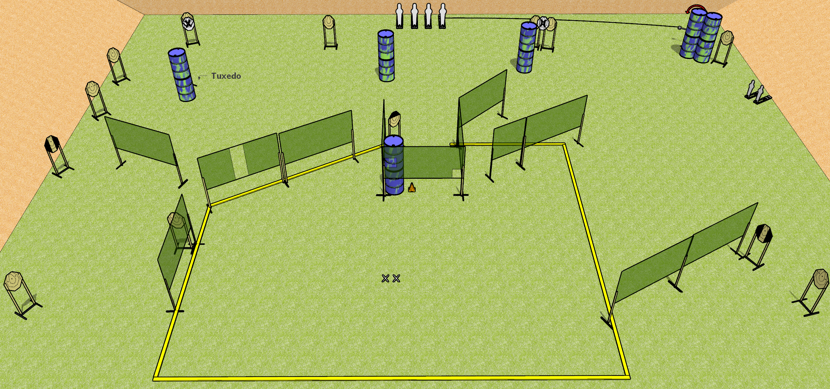
 | Dothan Gun Club – USPSA Match Gripes and Mikes Course Designer : Drew Coleman
START POSITION : Standing with both feet on X’s, hands relaxed at sides
GUN READY CONDITION : Pistol loaded and holstered. PCC loaded, shouldered, safety on, pointed at orange cone. |  | SCORING: Comstock, 36 rounds TARGETS: 15 paper, 6 Steel SCORED HITS: Best 2 on paper, steel until down START-STOP: Audible, last shot RULES:
STAGE PROCEDURE: Engage targets as they become available from within the fault lines.

Slide 15
Gripes and Mikes
Written Stage Briefing
Gripes and Mikes is a 36 round, 180 point, Comstock field course. There are fifteen IPSC paper targets, four pepper poppers, and two mini poppers. The best two hits per target will score. Steel must fall to score. The start signal is audible.
The handgun start position is standing inside the shooting area with both feet on X’s with hands relaxed at sides. Handgun is loaded and holstered.
The PCC start position is standing inside the shooting area with both feet on X’s. Loaded carbine held in both hands, safety on, shouldered, muzzle pointed orange cone.
Upon start signal, engage targets as they become available from within the shooting area.

